Slide 1


Team 29: Shoe AR
Bi-Weekly Update 3 Santiago Cantu, Alvaro Espinoza, Ulises Aguilera, Brandon Smith Sponsor: Pranav Dhulipala TA: Eric Robles

Slide 2

Executive Summary
Problem Statement: Shopping for shoes online lacks the in-store benefits of trying on a shoe to ensure the correct size and viewing how the shoe looks on your feet.
Solution Proposal: Create a shoe AR application that measures the size of your foot, provides you the correct shoe size regardless of brand, and allows you to see how the shoe would look on your foot with augmented reality.

Slide 3
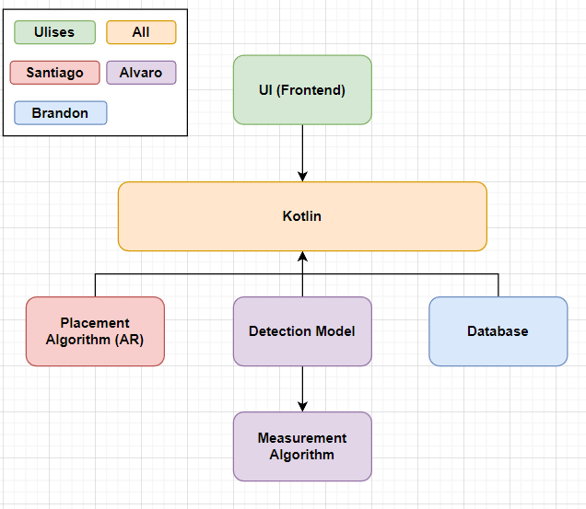
System Block Diagram
UI:​
Storefront
Camera
Kotlin:​​
Information transfer
Database:​
Shoe models
Placement Algorithm:​
Superimposition
Detection Model:
Foot Detection​
Measurement Algorithm:​​
Foot size

Slide 4
Project Timeline
Subsystem Designs and Testing (completed 9/21) | Integration of Database with UI (to complete by 10/5) | Integration of ML Model and AR Camera with UI and Database (to complete by 10/19) | Final Integration (to complete by 10/26) | System Test (to complete by 10/30) | Validation (to complete by 11/2) | Demo and Report (to complete by 12/2)
Notes:
Eric

Slide 5
Shoe Superimposition
Santiago Cantu
Accomplishments since Status Update 2 12 hrs | Ongoing progress/problems and plans until the next presentation
Completed shoe transformation tests in preparation for integration with Foot Detection Scaling issue Completed integration of AR camera with the Frontend | Ongoing integration with the other subsystems Assisting in other subsystem integrations to understand what data will be passed/pulled

Slide 6
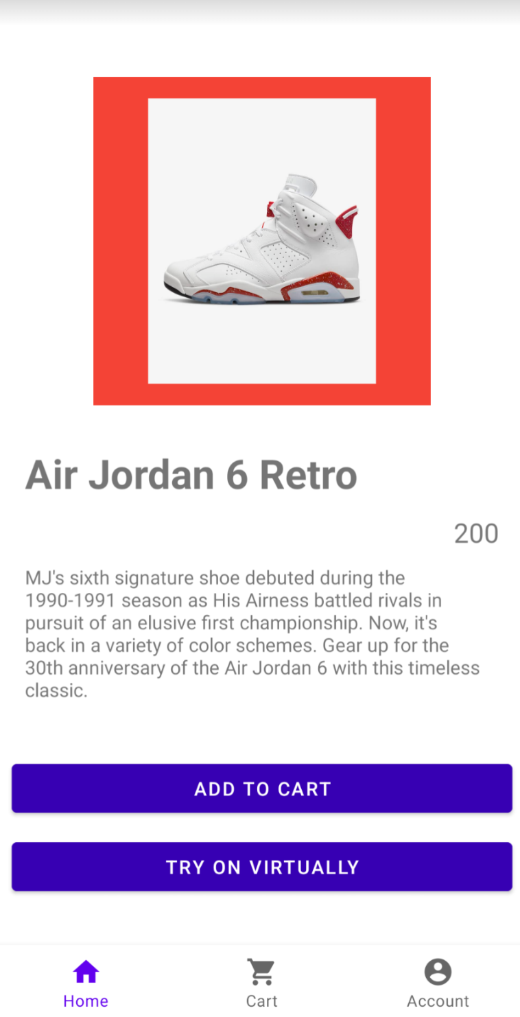
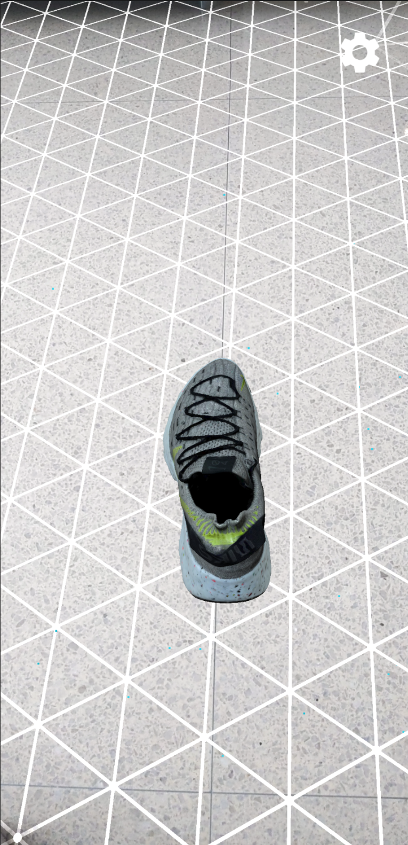
Shoe Superimposition Santiago Cantu

Slide 7
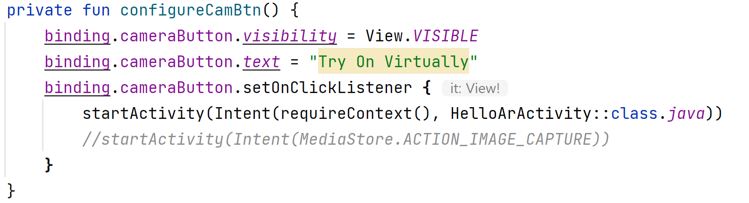
Shoe Superimposition Santiago Cantu

Slide 8
Database/Backend
Brandon Smith
Accomplishments since Status Update 2 18hrs | Ongoing progress/problems and plans until the next presentation
Kotlin Room structure has been implemented and this structure has been added to the app files Database tables were consolidated and simplified into a singular table for ease of use | Finish query integration with frontend and test all queries to ensure correct files are pulled Assist with debugging database functions

Slide 9
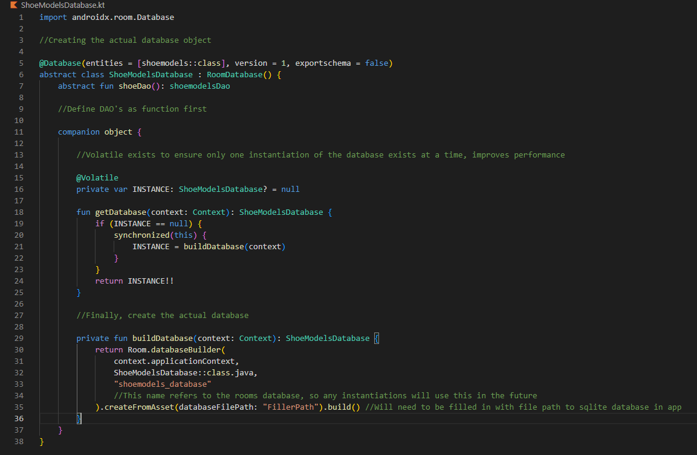
Database/Backend Brandon Smith

Slide 10
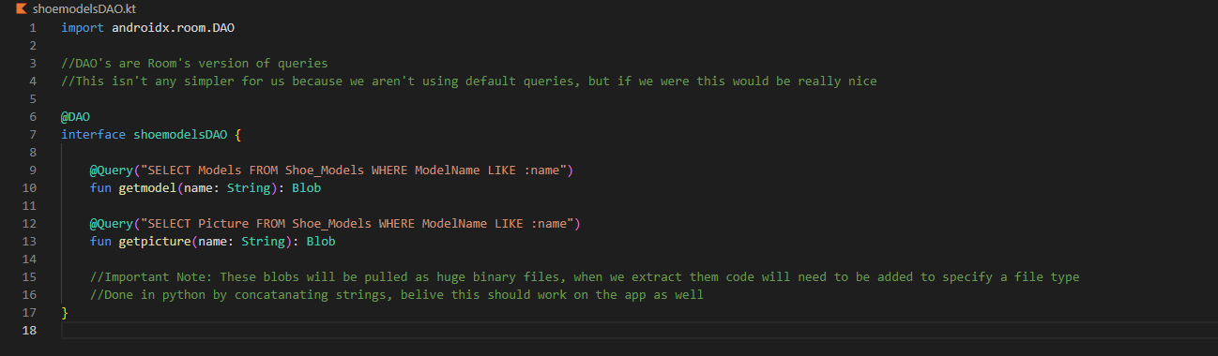
Database/Backend Brandon Smith

Slide 11
Frontend
Ulises Aguilera
Accomplishments Status Update 2 14hrs | Ongoing progress/problems and plans until the next presentation
Integrated DB using Kotlin Rooms (without pictures or models) | Work with Brandon to complete DB and Queries Integrate AR Camera and ML

Slide 12
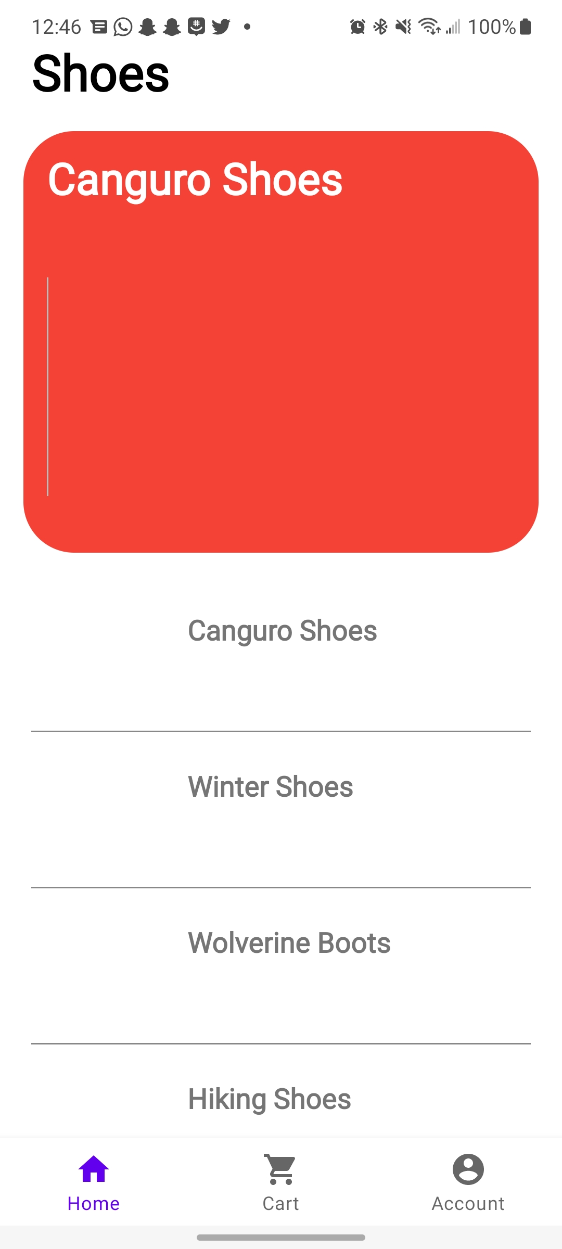
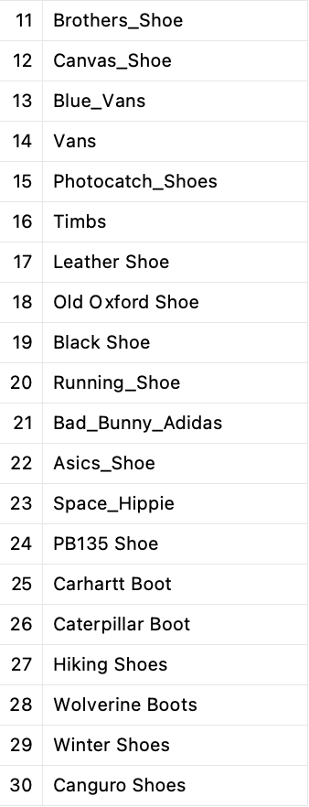
Frontend Ulises Aguilera

Slide 13
Detection Model
Alvaro Espinoza
Accomplishments since Status Update 2 15 hrs | Ongoing progress/problems and plans until the next presentation
Finished TfLite conversion Integrated model into a Google Codelab test app Tested model on a Google Pixel 3 emulator | Finish integration onto current app build Test model on Google Pixel 3 hardware

Slide 14
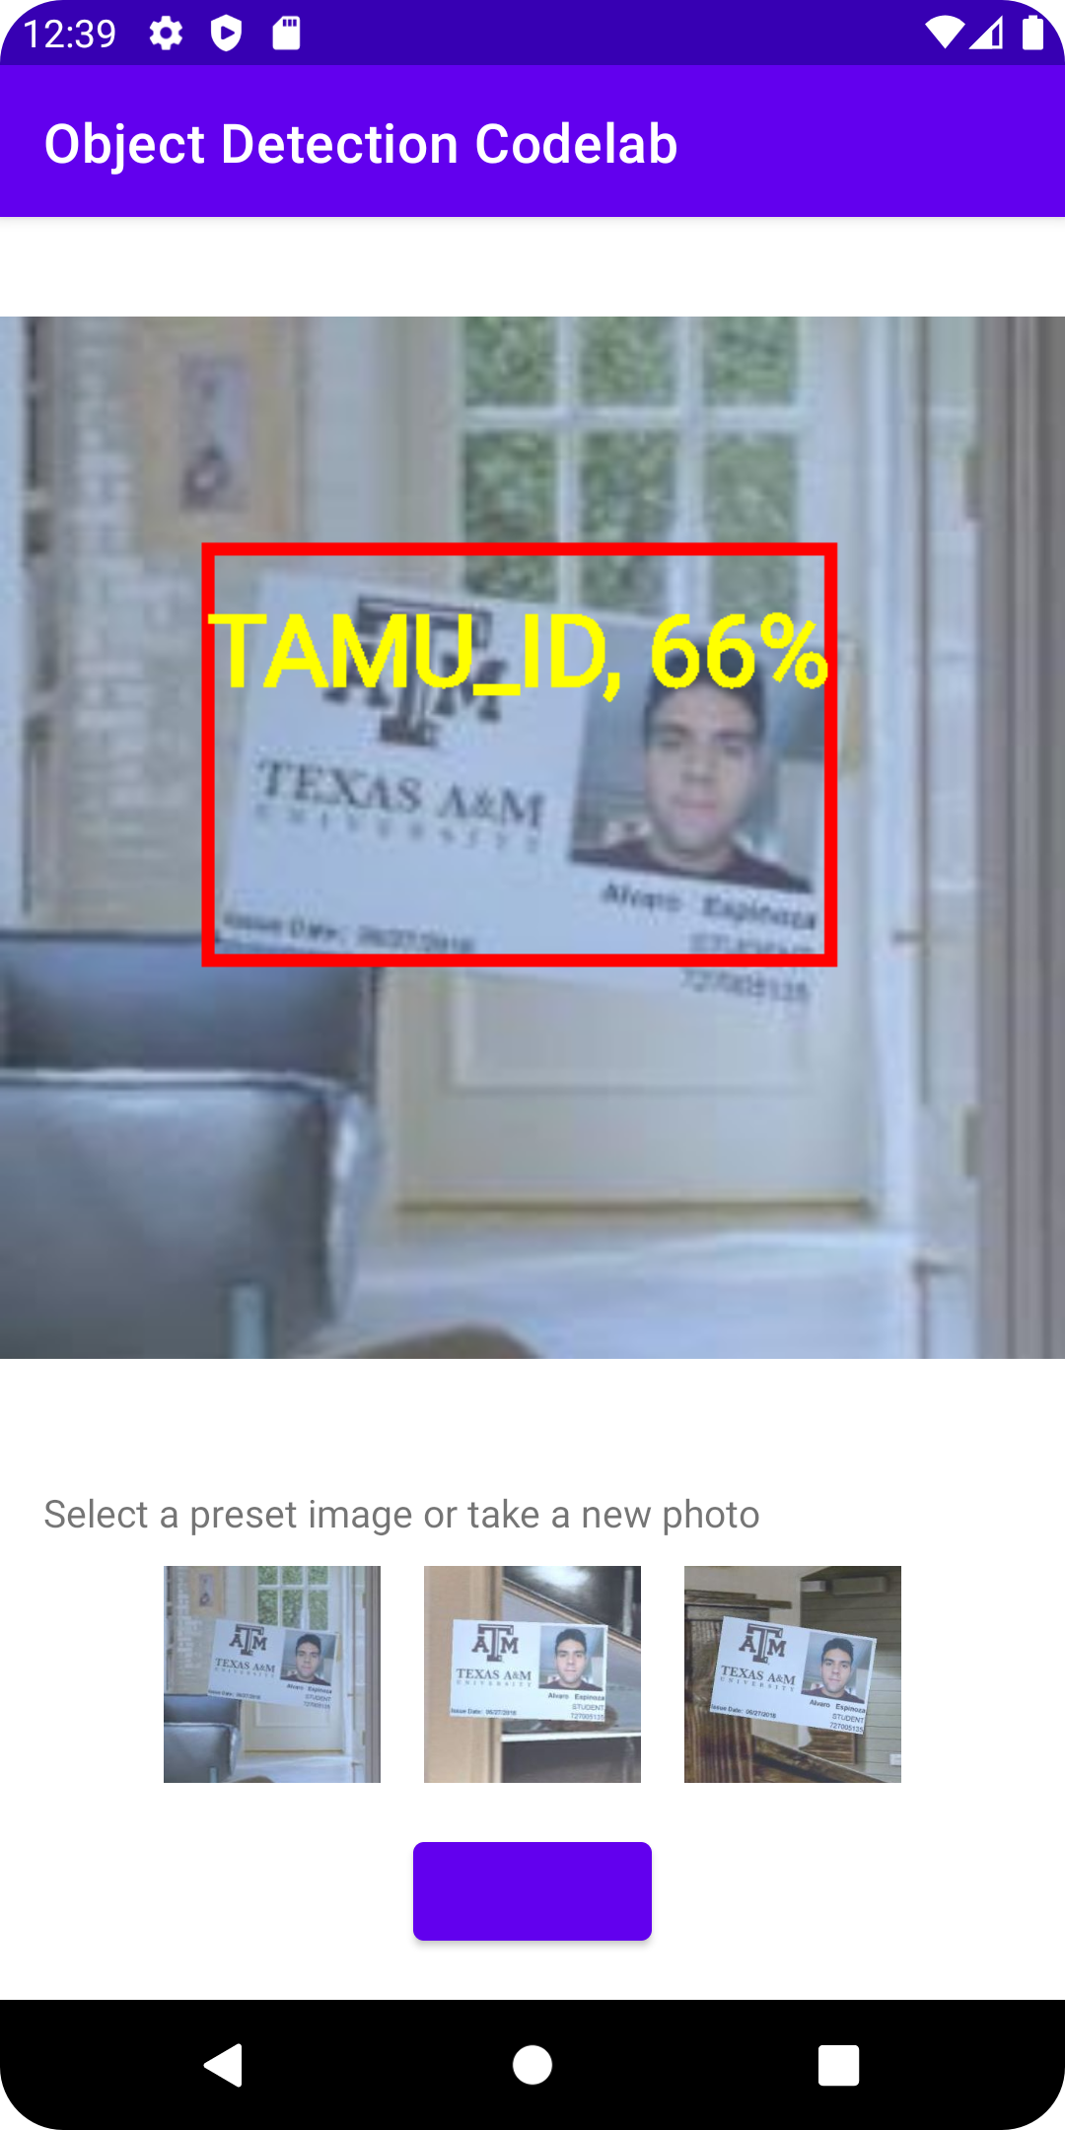
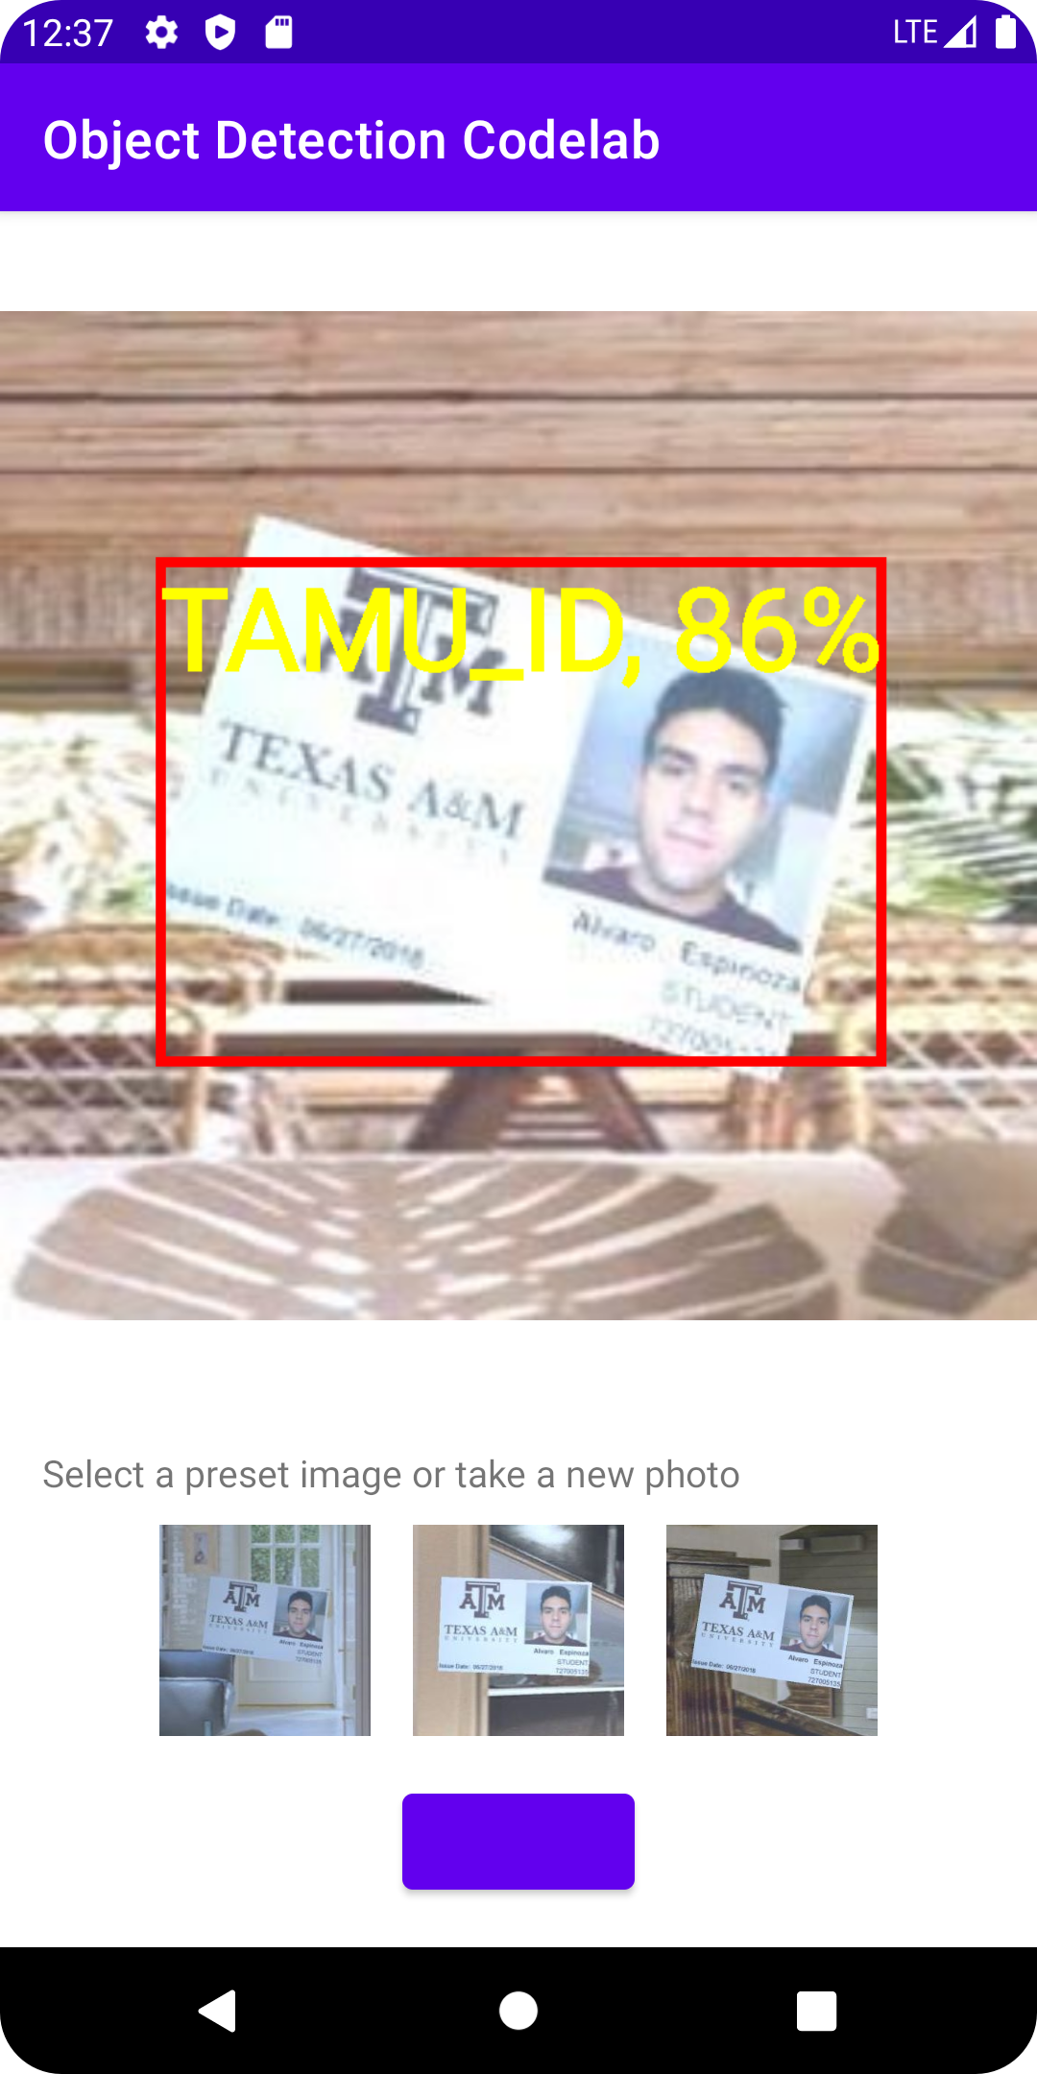
Detection Model Alvaro Espinoza

Slide 15
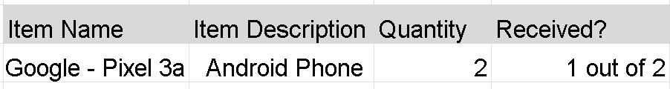
Part Ordering Status

Slide 16
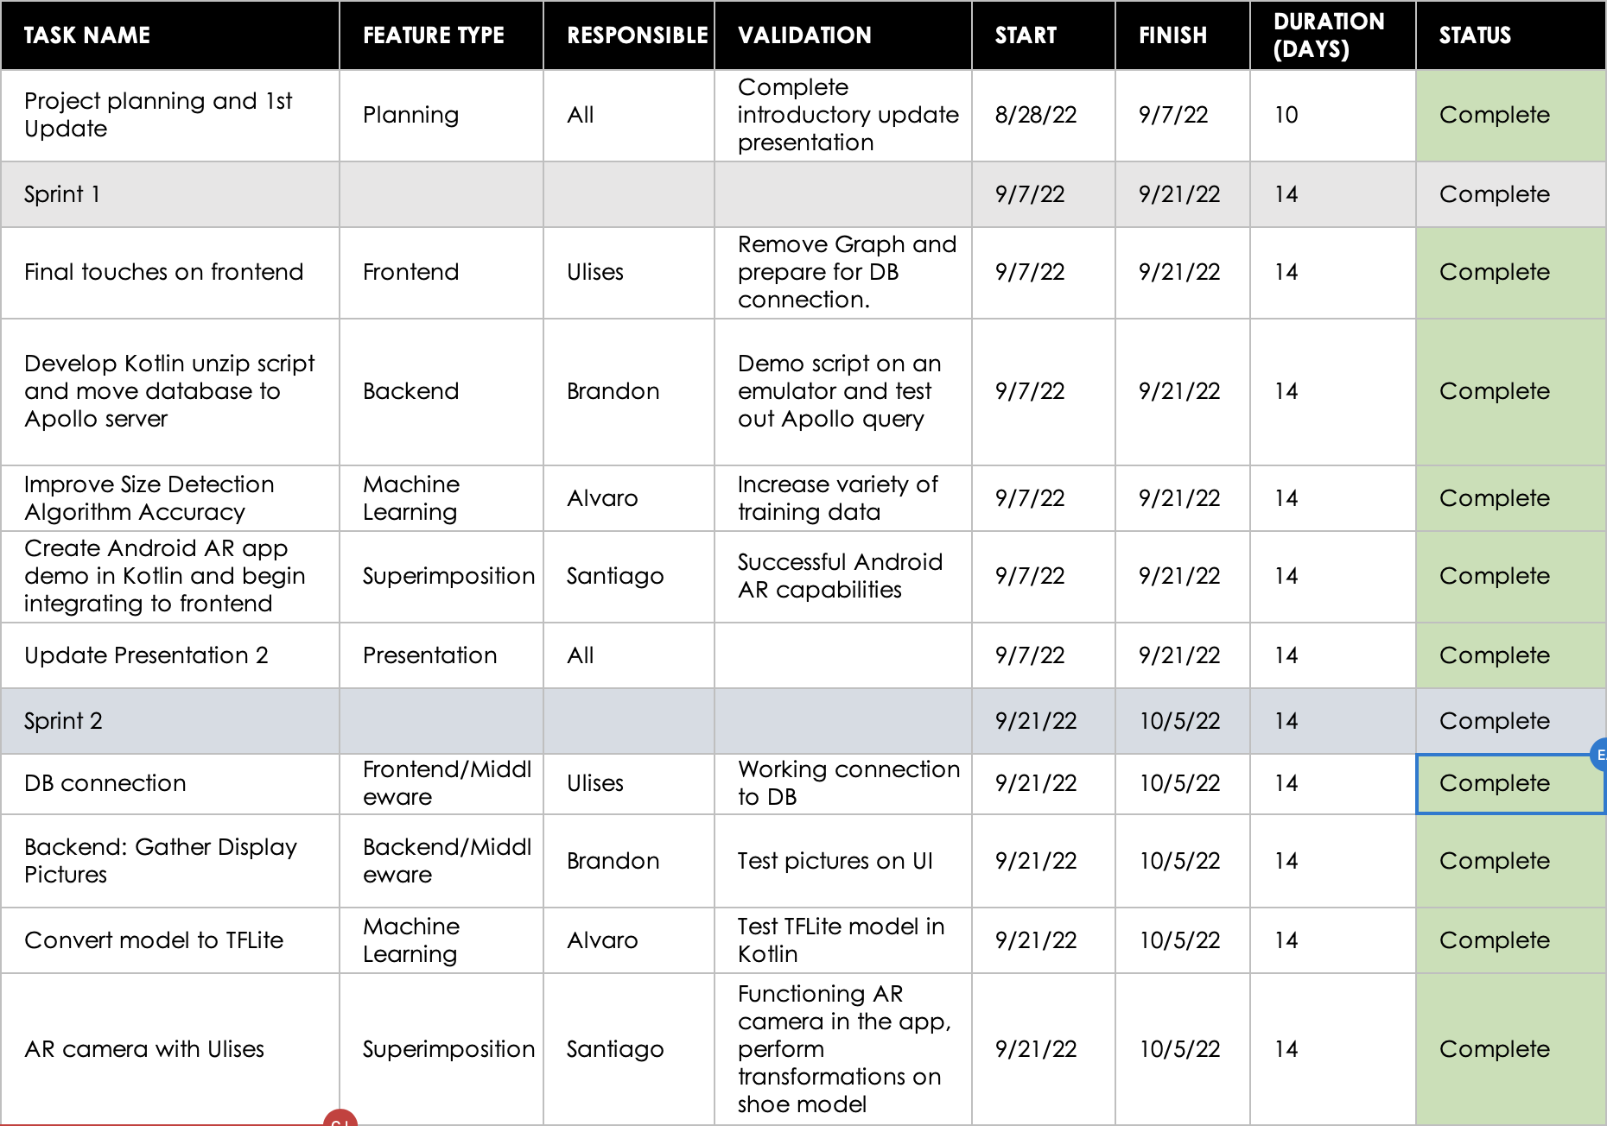
Execution & Validation Plan
Notes:
Michelle

Slide 17
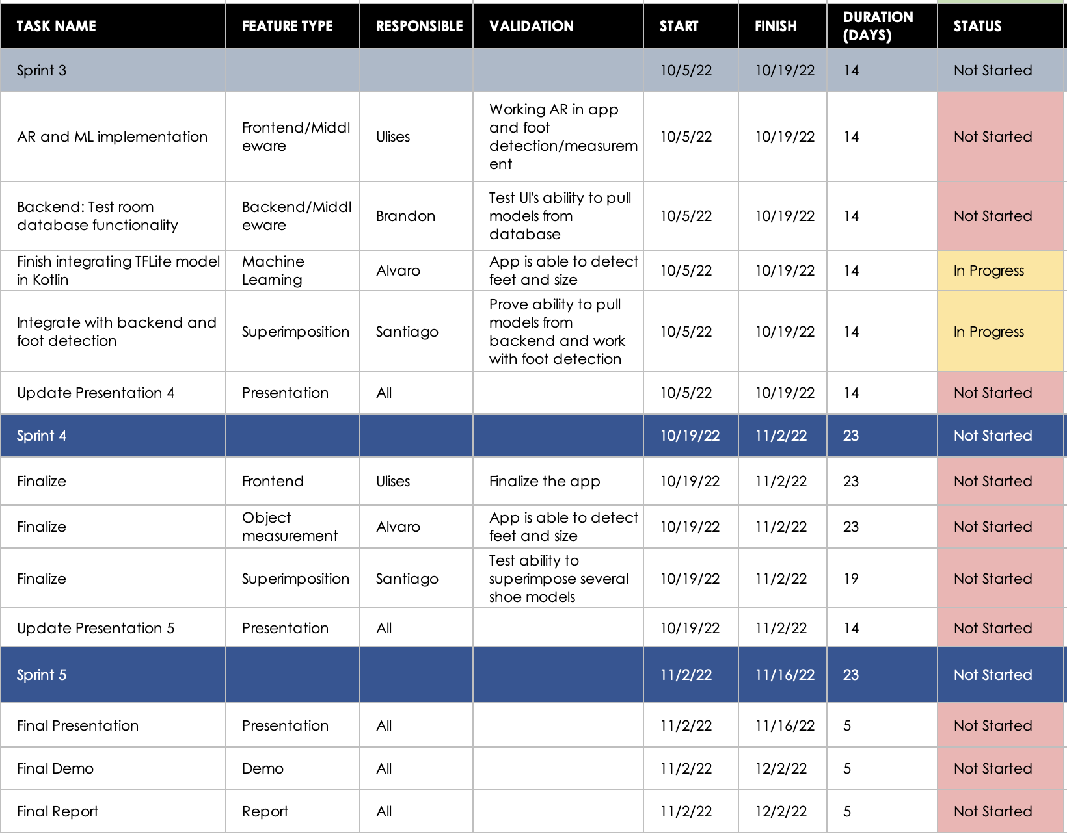
Execution & Validation Plan
Notes:
Michelle

Slide 18
Thank you!
Questions?

